Slide 1

George Williams is currently a student at Hunter College planning to major in media, and a passionate gamer. He graduated from KIPP NYC College Prep in 2014 with the Advanced Regents Prep Diploma. He is currently employed at KIPP as a Teacher’s Assistant for a Science faculty of 13 teachers. He’s also been a soccer coach in Brooklyn for children aged 13 through 17. Surrounded by other teenagers that play games, he leverages his opportunities to discuss trends and gather insights in customer segments that have led to the growth of the gaming industry. His goal is to make a website that connects gamers to game developers.

Slide 2

Notes:
Personal Intro and transition to the project name
Time: 40-60 seconds

Slide 3
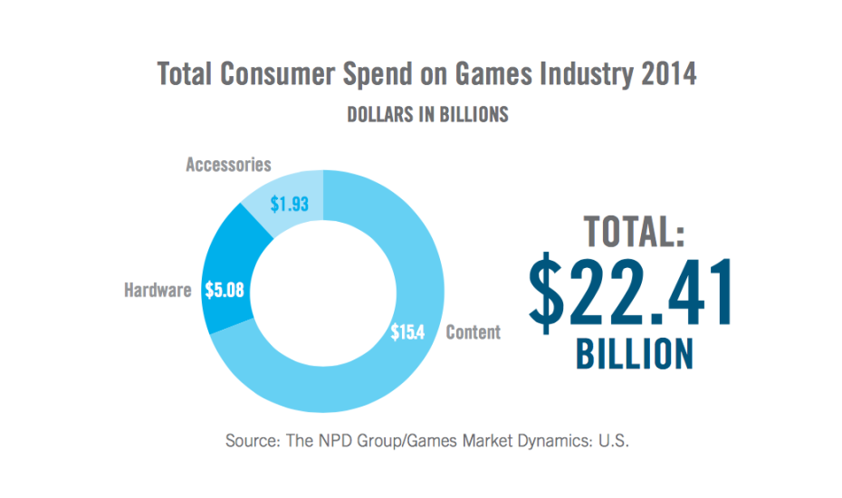
Market Opportunity

Slide 4
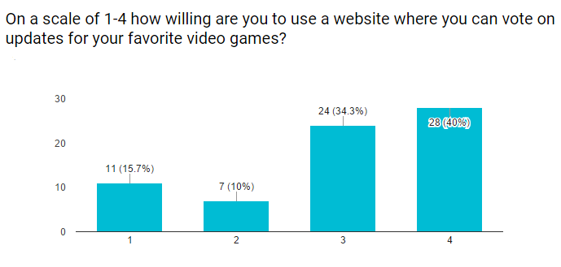
Customer Insights
~155 Million Americans play video games
80% of households own a gaming device

Slide 5
Value Proposition
Gamers space to voice their ideas
Developers gain a source to receive customer input; help push updates out faster
Developers gain a reliable space to advertise updates to a large base of gamers

Slide 6
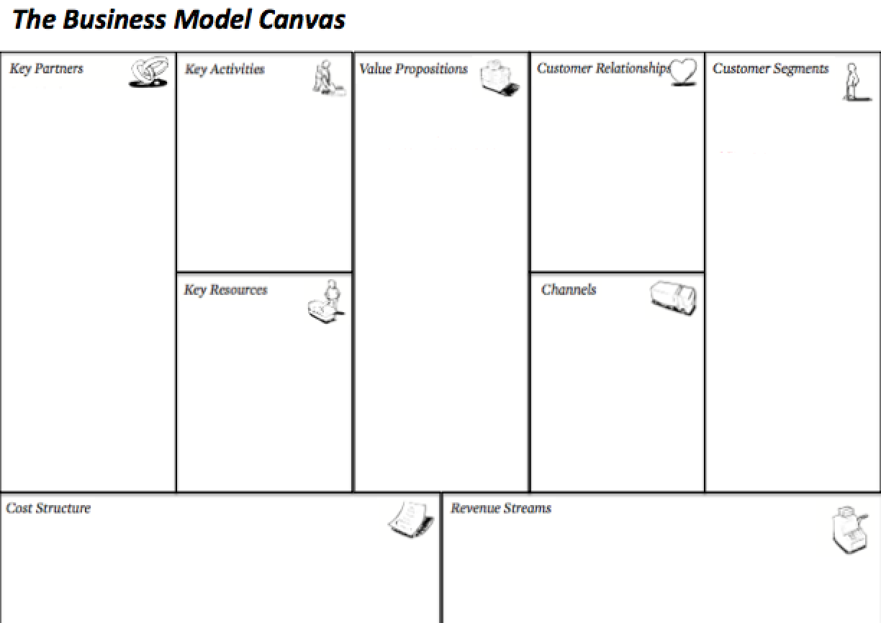
Exclusive access to new content
Low cost membership
Highly-sought feature access
Website development
Application development
Focus groups w/ game developers and gamers
Opinion Voicing- Gamers can offer update ideas
Ad Space for Devs- Devs get a concentrated base to advertise to
Account Linking- Users connect their game accounts
Walkthrough - Many users sought a walkthrough feature in my competitors
Gamers between the ages of 11 and 40
Developers of major video game companies
Survey goers expressed their age range not being represented, expanding age range to 60
GameStop
Twitch
Reddit
Game Developers
Users
Advertisement
Website
App
Domain Pricing
Website Management and Maintenance
Website Development
Sale of aggregate data to video game developers
Ad space for developers to advertise games
Subscription service for additional features
Notes:
Present what your initial thoughts were on your business model canvas; Contrast with what you learned from class, interviews and surveys and the changes you made to the canvas
Time: 80-120 seconds

Slide 7
Revenue Model
Subscription service for additional features
Sale of aggregate data to video game developers
Ad space for developers to advertise games

Slide 8
Strategy & Milestones
Deadline | Milestone | Strategy
Dec. 2017 | Final version of website | Partner with/hire developers expert in forum building; Get customer input on site features; Set up agreements with video game developers
Aug. 2018 | 3,000 monthly users | Partnerships with Twitch and GameStop to expand user base
Notes:
Describe how you will get your product out to the customer segments
Time: 40-60 sec

